Slide 1
SC-200T00A Microsoft Security Operations Analyst
Author name Date

Slide 2
Module 5: Configure your Azure Sentinel environment

Slide 3
Module agenda
Introduction to Azure Sentinel
Create and manage Azure Sentinel workspaces
Query logs in Azure Sentinel
Use watchlists in Azure Sentinel
Utilize threat intelligence in Azure Sentinel

Slide 4
Lesson 1: Introduction to Azure Sentinel

Slide 5
Lesson introduction
After this lesson, you will be able to:
Identify the various components and functionality of Azure Sentinel
Identify use cases where Azure Sentinel would be a good solution

Slide 6
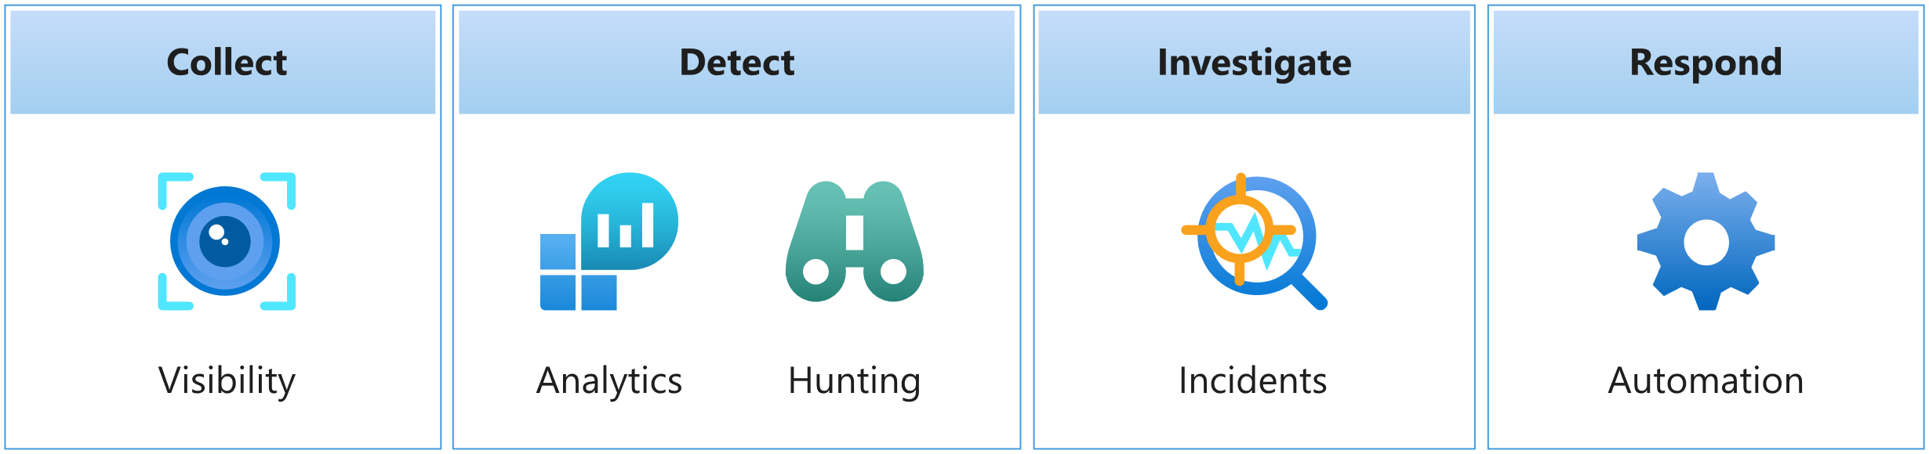
Azure Sentinel explained
Azure Sentinel is a cloud-native SIEM. A SIEM system is a tool that an organization uses to collect, analyze, and perform security operations on its computer systems.
Notes:
Supporting videos for instructor or student use:
Interactive guide: Modernize your security operations with Microsoft Azure Sentinel
https://aka.ms/AzureSentinel_SOC_InteractiveGuide
(15 minutes)

Slide 7
How Azure Sentinel works
Components of Azure Sentinel
Data connectors
Log retention
Workbooks
Analytics alerts
Threat hunting
Incidents and investigations
Automation playbooks

Slide 8
When to use Azure Sentinel
Azure Sentinel is a solution for performing security operations on your cloud and on-premises environments.
Use Azure Sentinel if you want to:
Collect event data from various sources.
Perform security operations on that data to identify suspicious activity
Security operations could include:
Visualization of log data.
Anomaly detection.
Threat hunting.
Security incident investigation
Automated response to alerts and incidents.
Decide whether it's the right fit for you:
Cloud-native SIEM. There are no servers to provision, so scaling is effortless.
Benefits of Microsoft research and machine learning.
Support for hybrid cloud and on-premises environments.
SIEM and a data lake all in one.
Clear requirements:
Support for data from multiple cloud environments
Features and functionality required for a security operations center (SOC), without too much administrative overhead

Slide 9
Section break

Slide 10
Lesson 2: Create and manage Azure Sentinel workspaces

Slide 11
Lesson introduction
After this lesson, you will be able to:
Describe Azure Sentinel workspace architecture
Install Azure Sentinel workspace
Manage an Azure Sentinel workspace

Slide 12
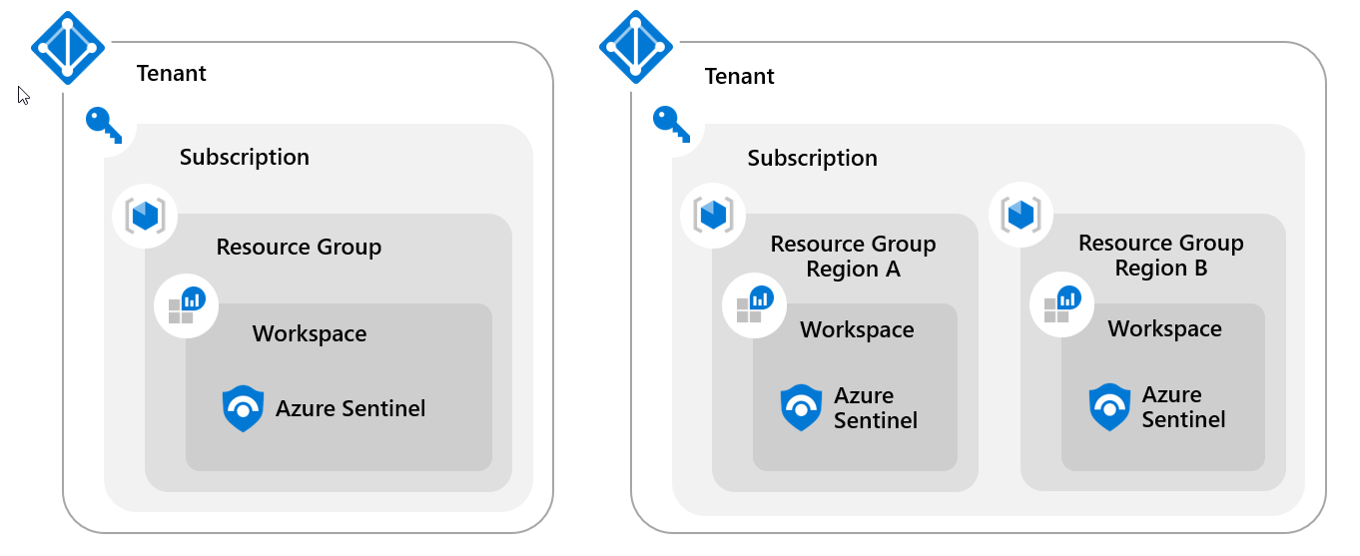
Plan for the Azure Sentinel workspace
1
Single-Tenant with a single Azure Sentinel Workspace
2
Single-Tenant with regional Azure Sentinel Workspaces
3
Multi-Tenant

Slide 13
Create an Azure Sentinel workspace
Azure Sentinel installation prerequisites
Have the required permissions for the Azure Subscription.
Create and configure a Log Analytics Workspace
Plan for the Region selection.
Add Azure Sentinel to the workspace
Select the newly created Log Analytics Workspace.
1
2
3

Slide 14
Azure Sentinel permissions and roles
Azure Sentinel-specific roles
Azure roles and Azure Monitor Log Analytics roles
Azure Sentinel roles and allowed actions
Custom roles and advanced Azure RBAC

Slide 15
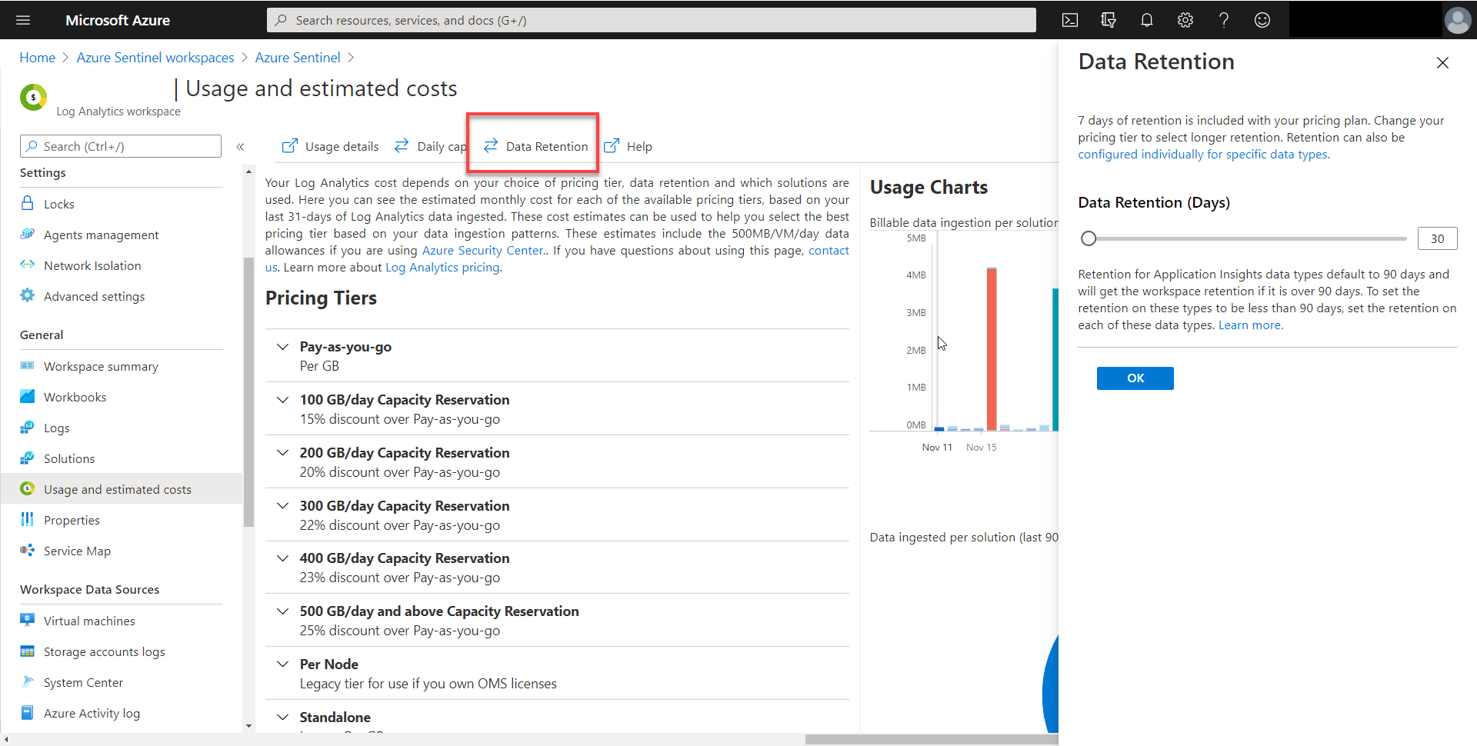
Manage Azure Sentinel settings
Azure Sentinel Environment Settings are managed in two areas. In Azure Sentinel and in the Log Analytics workspace where Azure Sentinel resides. To configure Log Retention:

Slide 16
Manage workspaces across tenants using Azure Lighthouse
If you are required to manage an Azure Sentinel workspace not in your tenant, implementing Azure Lighthouse will provide the option to enable your access to the tenant. Once Azure Lighthouse is onboarded, use the directory + subscription selector on the Azure portal to select all the subscriptions containing workspaces you manage.
Notes:
Instructor demonstrate:
- Create Azure Sentinel Workspace

Slide 17
Section break

Slide 18
Lesson 3: Query logs in Azure Sentinel

Slide 19
Lesson introduction
After this lesson, you will be able to:
Use the Logs page to view data tables in Azure Sentinel
Query the most used tables using Azure Sentinel

Slide 20
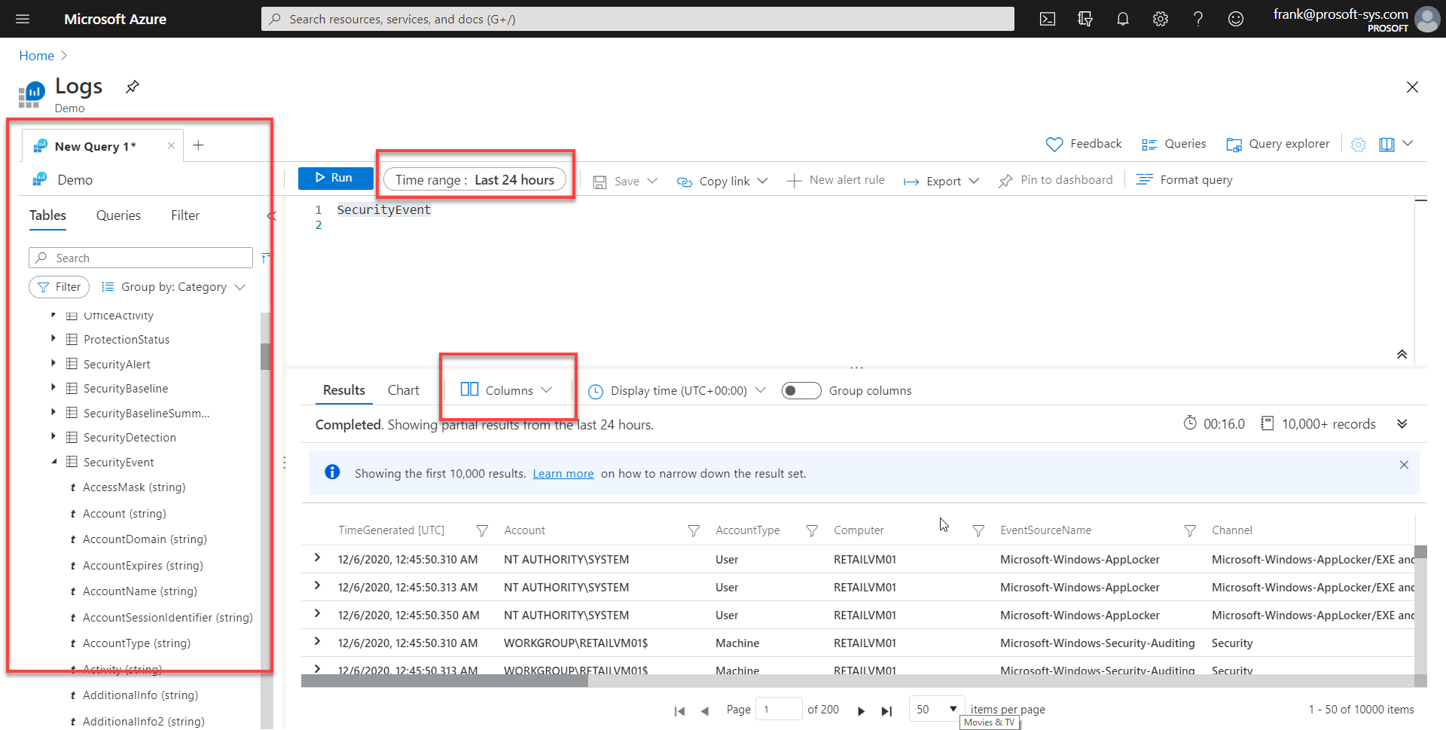
Query logs in the logs page
The query window allows you to run queries, save queries, run saved queries, create a new alert rule, and export.

Slide 21
Understand Azure Sentinel tables
Table: | Description
SecurityAlert | Contains Alerts Generated from Sentinel Analytical Rules. Also, it could include Alerts created directly from a Sentinel Data Connector
SecurityIncident | Alerts can generate Incidents. Incidents are related to Alert(s).
ThreatIntelligenceIndictor | Contains user-created or data connector ingested Indicators such as File Hashes, IP Addresses, Domains.
Watchlist | An Azure Sentinel watchlist contains imported data.

Slide 22
Understand common tables
Table: | Description
AzureActivity | Entries from the Azure Activity log
AzureDiagnostics | Stores resource logs for services that use Azure Diagnostics mode.
AuditLogs | Audit log for Azure Active Directory.
CommonSecurityLog | Syslog messages using the Common Event Format (CEF).
OfficeActivity | Audit logs for Office 365 tenants (Exchange, SharePoint and Teams).
SecurityEvent | Security events collected from windows devices.
SigninLogs | Azure Activity Directory Sign in logs.
Syslog | Syslog events on Linux computers using the Log Analytics agent.
Event | Sysmon Events collected from a Windows host.
WindowsFirewall | Windows Firewall Events

Slide 23
Understand Microsoft 365 Defender tables
Table: | Description
DeviceEvents | Device events table contains information about various event types.
DeviceFileEvents | File creation, modification, and other file system events.
DeviceImageLoadEvents | DLL loading events.
DeviceInfo | Including their OS version, active users, and computer name.
DeviceLogonEvents | User logons and other authentication events.
DeviceNetworkEvents | Network connections and related events.
DeviceNetworkInfo | Including network adapters, IP and MAC addresses, and connected networks or domains.
DeviceProcessEvents | Process creation and related events.
DeviceRegistryEvents | Creation and modification of registry entries.
Notes:
Instructor demonstrate:
Explore tables in the Logs page

Slide 24
Section break

Slide 25
Lesson 4: Use watchlists in Azure Sentinel

Slide 26
Lesson introduction
After this lesson, you will be able to:
Create a watchlist in Azure Sentinel
Use KQL to access the watchlist in Azure Sentinel

Slide 27
Plan for Azure Sentinel watchlists
1
Investigating threats and responding to incidents quickly with the rapid import of IP addresses, file hashes, and other data from CSV files. Once imported, you can use watchlist name-value pairs for joins and filters in alert rules, threat hunting, workbooks, notebooks, and general queries.
2
Importing business data as a watchlist. For example, import user lists with privileged system access, or terminated employees, and then use the watchlist to create allow and deny lists used to detect or prevent those users from logging in to the network.
3
Reducing alert fatigue. Create allow lists to suppress alerts from a group of users, such as users from authorized IP addresses that perform tasks that would normally trigger the alert, and prevent benign events from becoming alerts.
4
Enriching event data. Use watchlists to enrich your event data with name-value combinations derived from external data sources.

Slide 28
Create a watchlist
KQL:
_GetWatchlist('HighValueMachines')
Notes:
Instructor demonstrate:
Create and query a watchlist

Slide 29
Section break

Slide 30
Lesson 5: Utilize threat intelligence in Azure Sentinel

Slide 31
Lesson introduction
After this lesson, you will be able to:
Manage threat indicators in Azure Sentinel
Use KQL to access threat indicators in Azure Sentinel

Slide 32
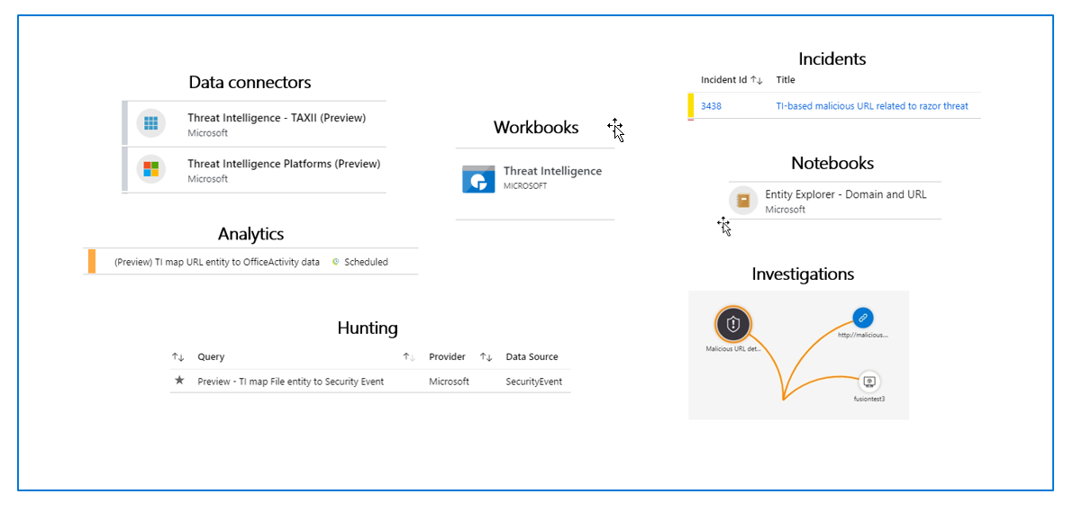
Define threat intelligence
Threat indicators are data that associate observations such as URLs, file hashes, or IP addresses with known threat activity such as phishing, botnets, or malware.

Slide 33
Manage your threat indicators
In the Threat intelligence area, you can view, sort, filter, and search your imported threat indicators without even writing a Logs KQL query. This area also allows you to create threat indicators directly within the Azure Sentinel interface and perform everyday threat intelligence administrative tasks like indicator tagging and creating new indicators related to security investigations.

Slide 34
View your threat indicators with KQL
The indicators can be accessed in KQL by querying the ThreatIntelligenceIndicator
table.
//KQL
ThreatIntelligenceIndicator
Notes:
Instructor demonstrate:
Create and query an indicator

Slide 35
Section break

Slide 36
Knowledge check
Check your knowledge with the module quiz in your course viewer

Slide 37
Lab 01 – Configure your Azure Sentinel environment

Slide 38
Lab Exercises
1
Configure your Azure Sentinel environment

Slide 39
Closing slide

